Slide 1

Marketing Business Intelligence Insights & Strategies
TECHNICAL CHALLANGE AUTOFORCE
Leveraging Data for Enhanced Marketing Effectiveness
Ricardo V M Almeida | BI Analyst (candidate)
3nd January 2024

Slide 2

About Me
Professional experience
Data Scientist / BI Analytics on Ioasys/Alpargatas SA:
"At ioasys, I managed E-commerce and OMNI model pipelines, using Python, PySpark and SQL.“
Keywords: E-commerce, OMNI, Python, PySpark, SQL.
Research at Alana AI and Federal University of Rio Grande do Norte:
"My experience in research and as a Data Manager at Alana AI gave me unique skills in...“
Keywords: AWS, Confluence, Bitbucket, ML, AI.

Slide 3
About Me
My experience in querying and extracting data via SQL from Data Warehouses, and analysis via Google Analytics aligns with...
Keywords: SQL, Data Warehouse, Google Analytics.
Developed and maintained advanced dashboards in...
Keywords: Google Data Studio, Tableau, PowerBI.
My background includes presenting analysis and insights to support...
Keywords: Business Evolution, Project Initiatives, Strategic Decisions.

Slide 4
Agenda
Overview of key points and sections of the presentation.
01. Introduction to Data Analysis
02. Product Pricing Strategy
03. Brand Positioning and Inventory Management
04. Customer Engagement
05. Temporal Patterns in Customer Behavior
06. Data-Driven Decision Making
07. New Dataset | Makeup
08. Consumer Category Behavior
09. Conclusion
10. Q&A and feedback

Slide 5
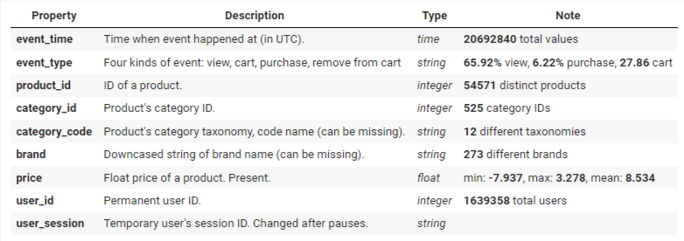
Introduction
Brief overview of the data and analysis methodology.
This dataset includes behavioral data from a mid-sized cosmetics online store from Oct. 2019 to Jan. 2020. Each entry in this dataset represents an event related to products and users. The events consist of different types such as views, items added to cart, items removed from cart, and purchases.

Slide 6
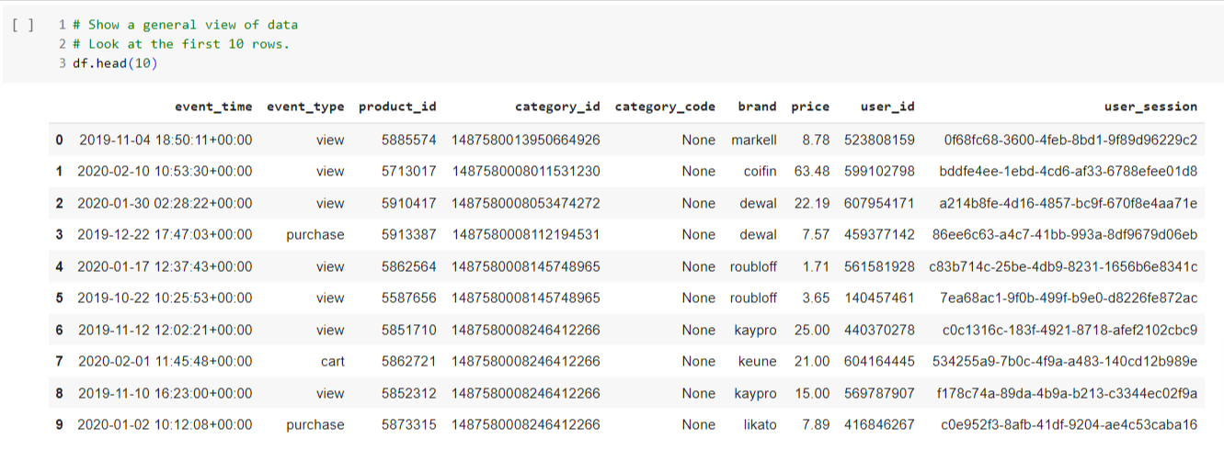
Introduction
Brief overview of the data and analysis methodology.

Slide 7
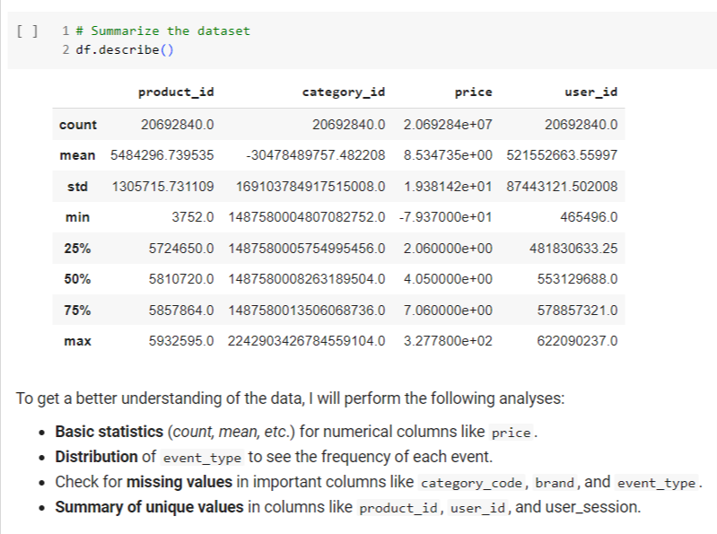
Introduction
Brief overview of the data and analysis methodology.
To an Exploratory Data Analysis (EDA) is a critical step in understanding your data, identifying patterns, spotting anomalies, and testing hypotheses. Let's delve into the importance of analyzing specific aspects such as products with zero prices, the relationship between prices and brands, and the patterns in event times:

Slide 8
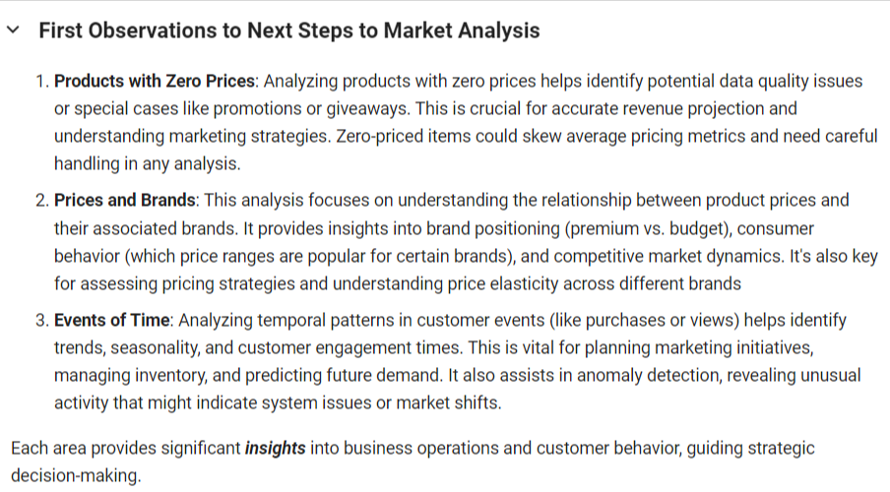
Introduction
Brief overview of the data and analysis methodology.
To an Exploratory Data Analysis (EDA) is a critical step in understanding your data, identifying patterns, spotting anomalies, and testing hypotheses. Let's delve into the importance of analyzing specific aspects such as products with zero prices, the relationship between prices and brands, and the patterns in event times:
OBS.: For the functionality of this presentation, it is necessary to view the descriptive analysis of the data through Google Colab Notebook [Link].

Slide 9

Data Analysis with Market Insights
This study presents a comprehensive analysis of consumer behavior and product performance in an online cosmetics store, covering the period from October 2019 to February 2020. By leveraging advanced analytics techniques, the report aims to unearth patterns, trends, and actionable insights from complex datasets.
In the dynamic realm of online retail, the role of a marketing business intelligence analyst is pivotal in steering strategic decisions through data-driven insights.
Such analyses are indispensable for a marketing business intelligence analyst, as they illuminate aspects like customer preferences, purchasing behavior, product popularity, and overall market dynamics.
The insights derived from the report are expected to inform crucial marketing strategies, optimize customer engagement, and drive business growth, ensuring that the company remains competitive and responsive to consumer needs in a constantly evolving digital marketplace.
Marketing Business Intelligence | Insights & Strategies

Slide 10
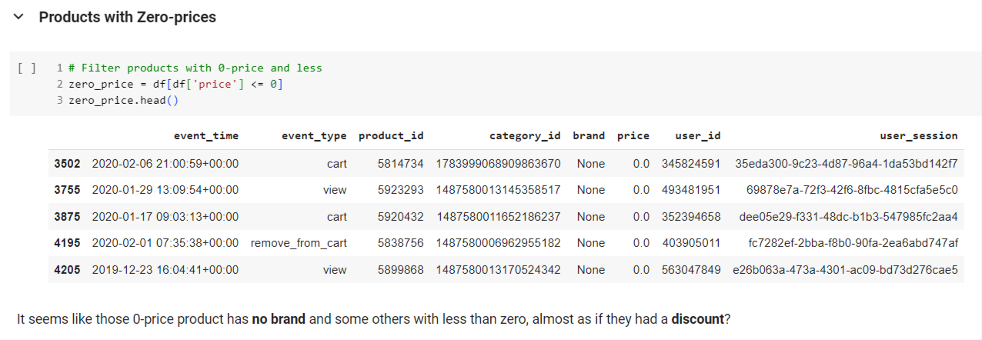
Product Pricing Strategy
Data findings on product pricing.
Marketing Business Intelligence | Insights & Strategies

Slide 11
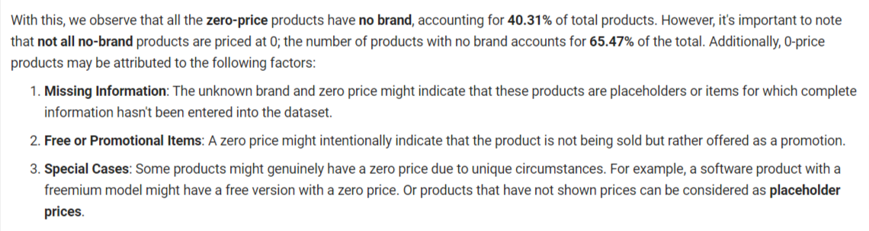
Product Pricing Strategy
Data findings on product pricing.
Marketing Business Intelligence | Insights & Strategies

Slide 12
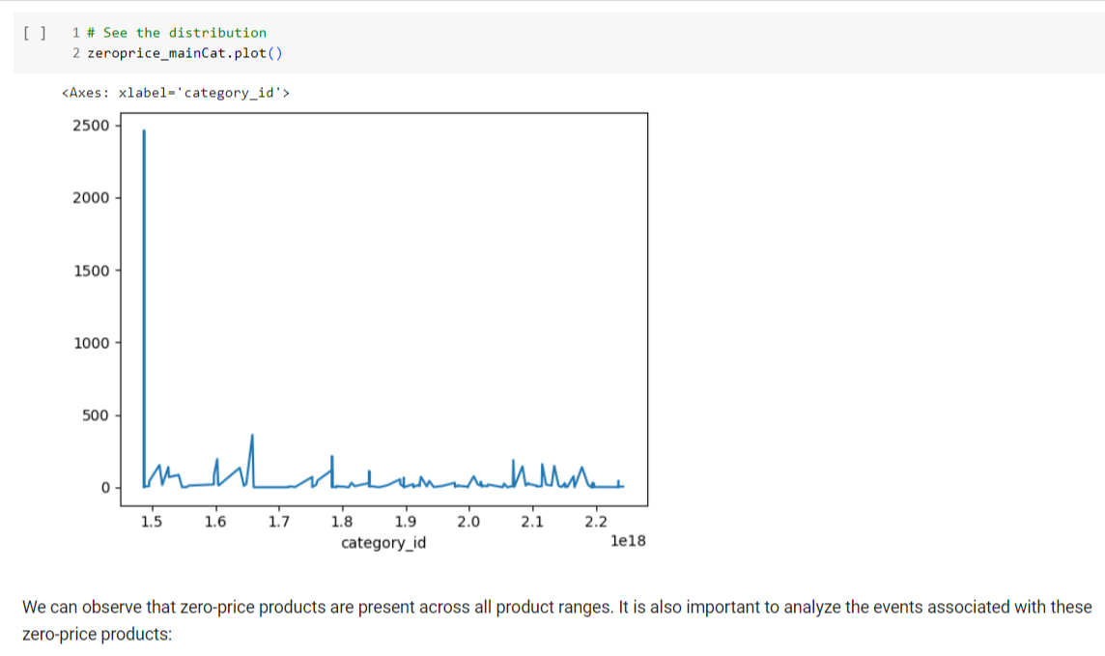
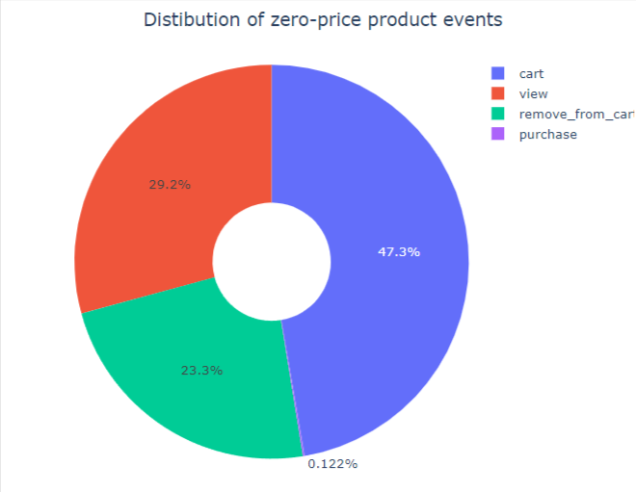
Product Pricing Strategy
Data findings on product pricing.
Marketing Business Intelligence | Insights & Strategies

Slide 13
Product Pricing Strategy
Insight:
The presence of a large number of zero-priced and low-priced products suggests potential data quality issues or unique pricing strategies like promotions or giveaways.
Suggestion:
Regularly review and clean product pricing data to ensure accuracy. Consider segmenting products into different pricing tiers for targeted marketing and pricing strategies.
Marketing Business Intelligence | Insights & Strategies

Slide 14
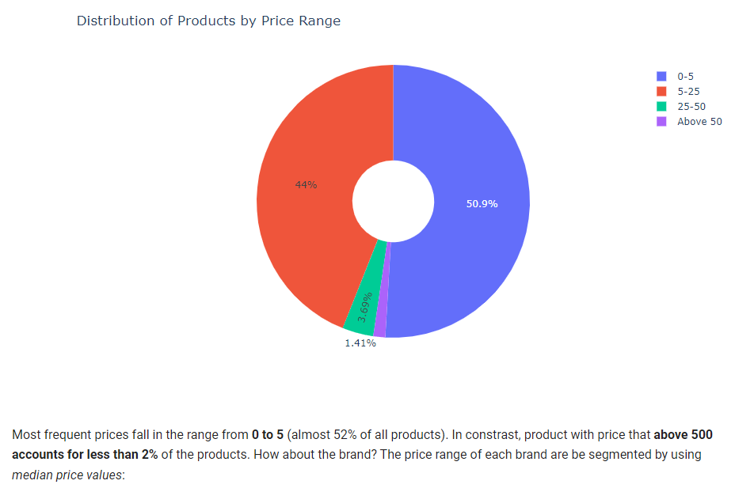
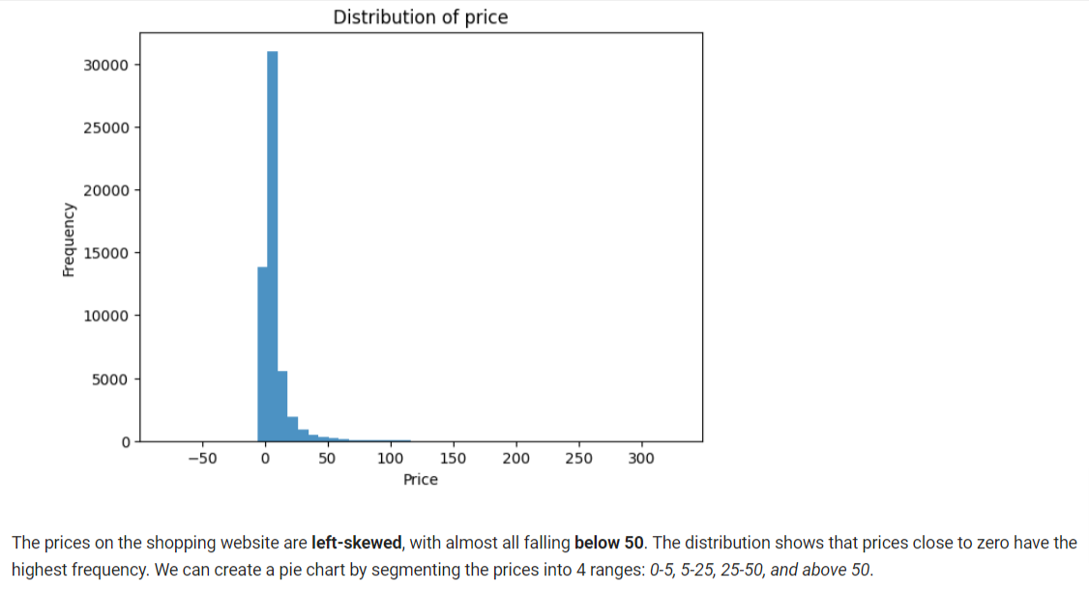
Brand Position and Inventory Management
Analysis of brand-related pricing patterns.
Marketing Business Intelligence | Insights & Strategies

Slide 15
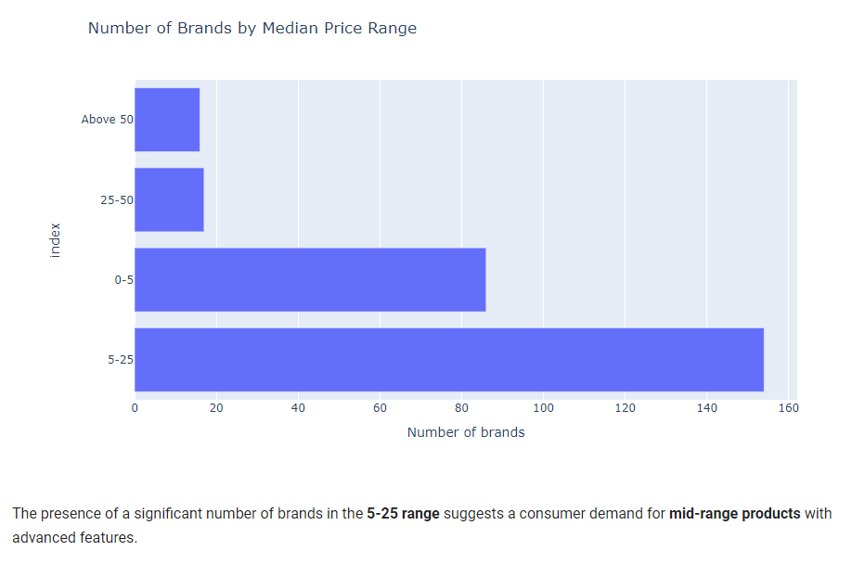
Brand Position and Inventory Management
Analysis of brand-related pricing patterns.
Marketing Business Intelligence | Insights & Strategies

Slide 16
Brand Position and Inventory Management
Insight:
The data shows variations in product prices across different brands, indicating different market positioning (premium vs. budget brands).
Suggestion:
Tailor marketing messages according to brand positioning. For premium brands, focus on quality and exclusivity, while for budget brands, highlight value and affordability. Adjust inventory based on brand popularity and pricing trends
Marketing Business Intelligence | Insights & Strategies

Slide 17
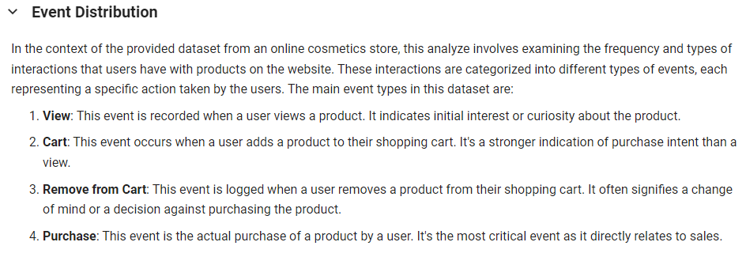
Customer Engagement
Engagement levels in different stages of the sales funnel.
Marketing Business Intelligence | Insights & Strategies

Slide 18
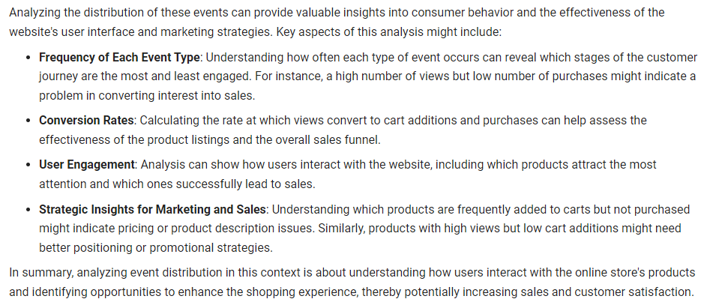
Customer Engagement
Engagement levels in different stages of the sales funnel.
Marketing Business Intelligence | Insights & Strategies

Slide 19
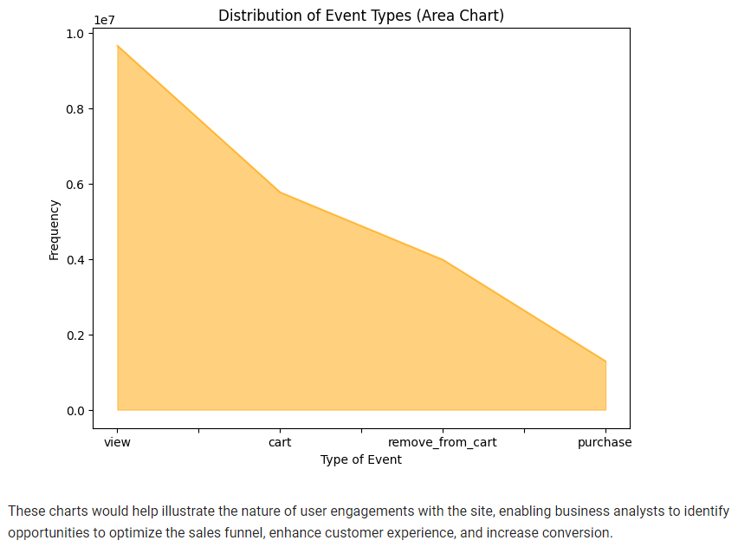
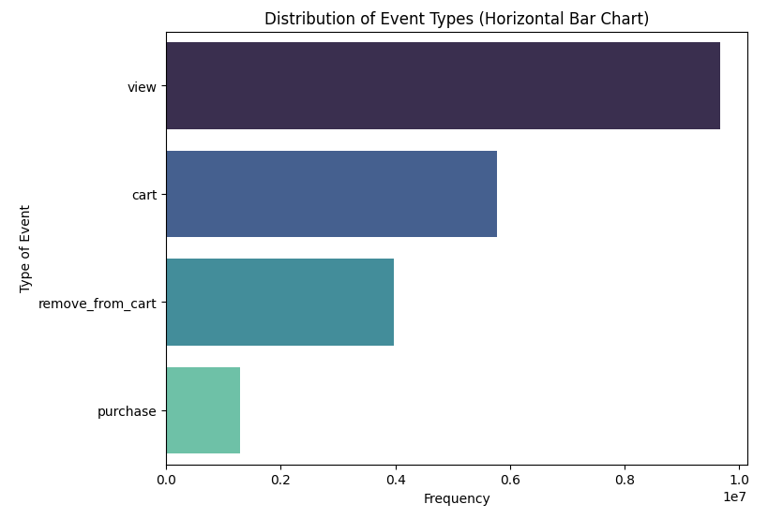
Customer Engagement
Engagement levels in different stages of the sales funnel.
Marketing Business Intelligence | Insights & Strategies

Slide 20
Customer Engagement
Insight:
Analysis of event types (views, carts, purchases) reveals how customers interact with the site, indicating different levels of engagement in the sales funnel.
Suggestion:
Develop strategies to move customers through the funnel more effectively. For example, target users who view products frequently with personalized recommendations or retargeting ads to encourage purchases.
Marketing Business Intelligence | Insights & Strategies

Slide 21
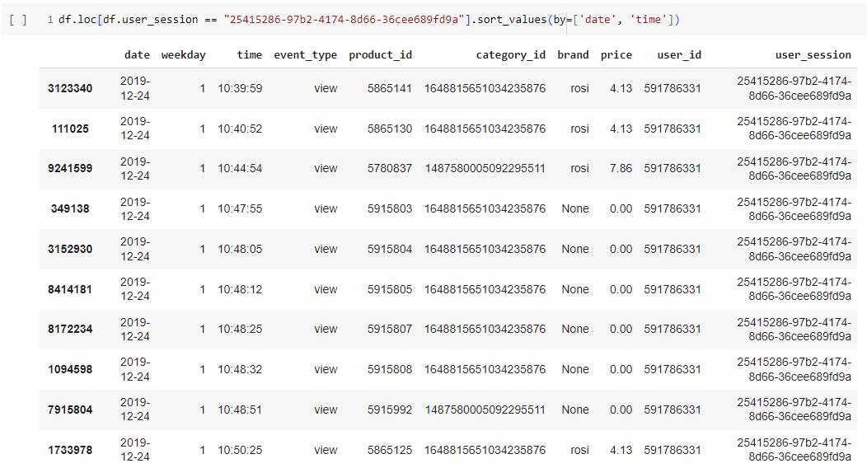
Temporal Patterns in Customer Behavior
Trends and seasonality observed in customer interactions.
Each customer is assigned their own ID for the corresponding customer account/IP. The dataset reflects customer behavior based on the events that they interacted with on the e-commerce cosmetics store platform.
Marketing Business Intelligence | Insights & Strategies

Slide 22
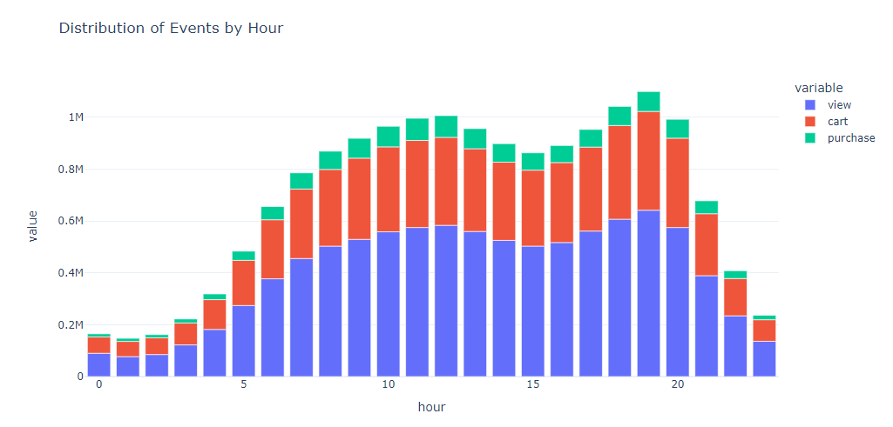
Temporal Patterns in Customer Behavior
Trends and seasonality observed in customer interactions.
Time Distribution Analysis
Marketing Business Intelligence | Insights & Strategies

Slide 23
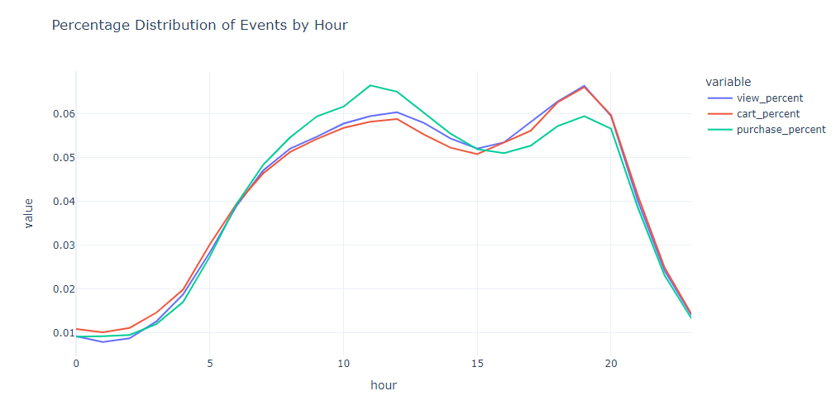
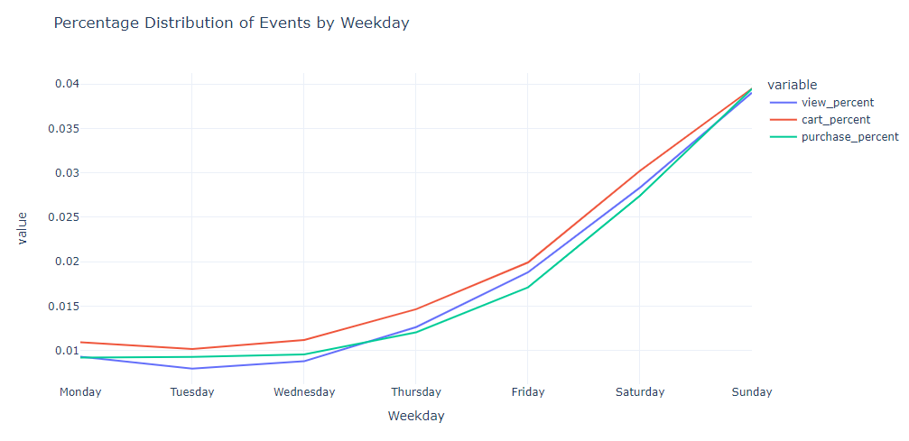
Temporal Patterns in Customer Behavior
Trends and seasonality observed in customer interactions.
Marketing Business Intelligence | Insights & Strategies

Slide 24
Temporal Patterns in Customer Behavior
Insight:
The time series analysis of product prices and customer events shows trends and seasonality in customer behavior.
Suggestion:
Leverage these insights for timing marketing campaigns, managing stock levels, and introducing dynamic pricing strategies during peak demand periods.
Marketing Business Intelligence | Insights & Strategies

Slide 25
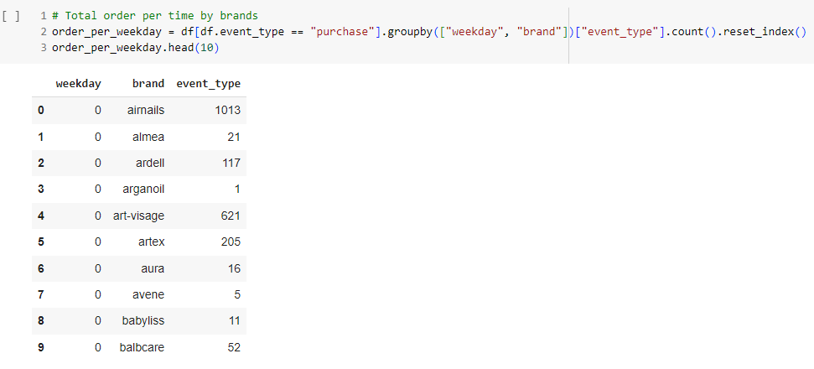
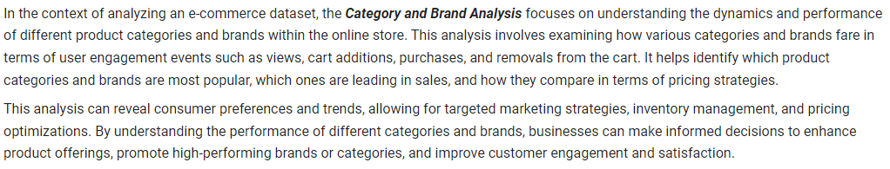
Data-Driven Decision Making
Marketing Business Intelligence | Insights & Strategies

Slide 26
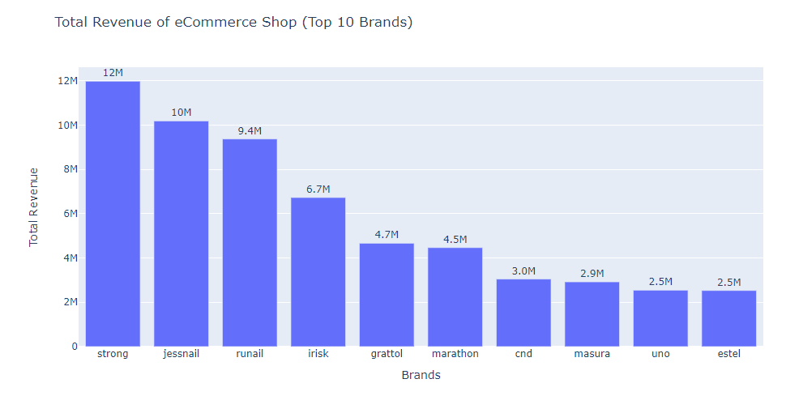
Data-Driven Decision Making
This analysis gives us an overview of how different categories and brands perform in terms of user engagement and price ranges. We can dig deeper to understand which categories and brands are more popular or generate more revenue, as well as study price trends in relation to popularity and conversion rate.
Marketing Business Intelligence | Insights & Strategies

Slide 27
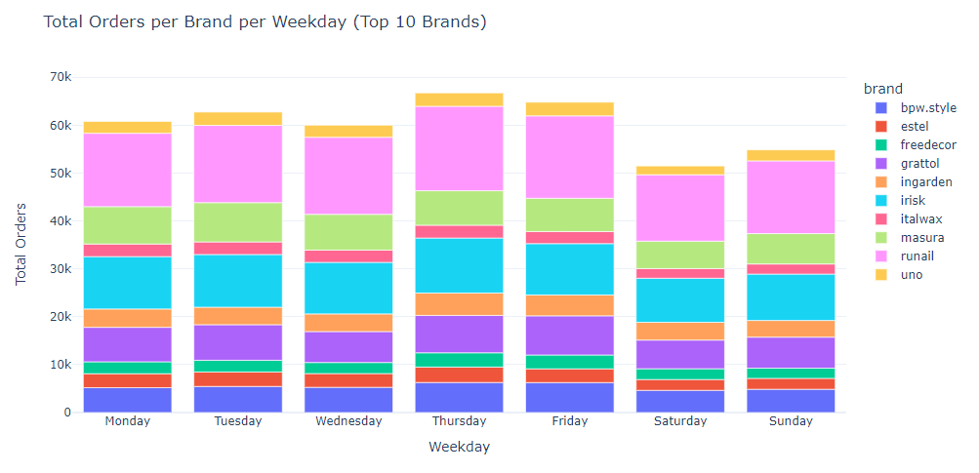
Data-Driven Decision Making
Marketing Business Intelligence | Insights & Strategies

Slide 28
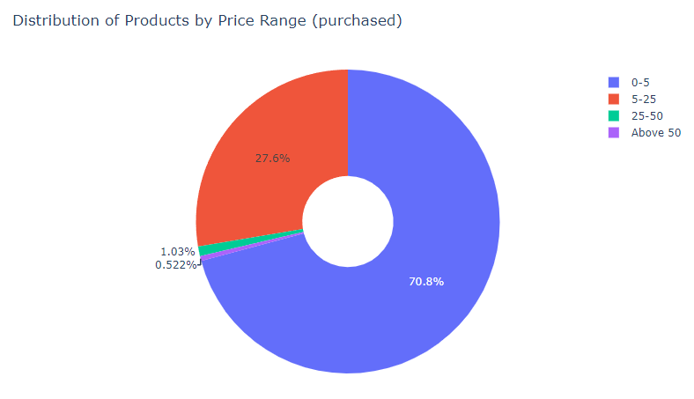
Data-Driven Decision Making
Insight:
The analysis demonstrates the power of data in uncovering insights about customer preferences, market trends, and operational efficiencies.
Suggestion:
Foster a culture of data-driven decision-making. Regularly analyze customer data to stay ahead of market trends, optimize marketing strategies, and enhance customer experience.
Marketing Business Intelligence | Insights & Strategies

Slide 29
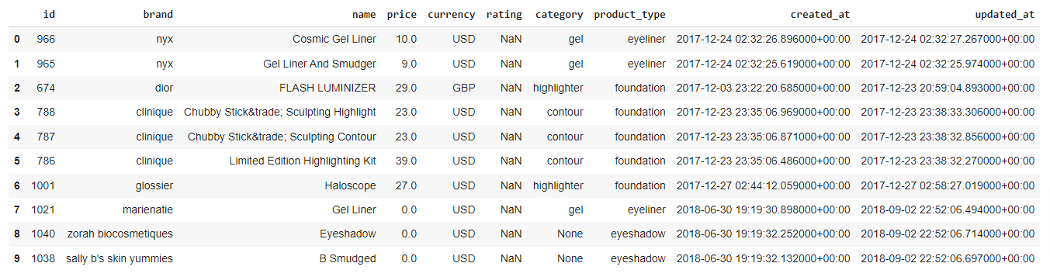
New Dataset | Makeup-api
Once again, since this is a new dataset with no correlation to the previous one, it is important to provide an overview of the information available about this data.
Marketing Business Intelligence | Insights & Strategies

Slide 30
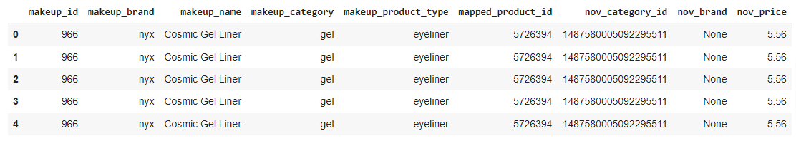
New Dataset | Makeup-api
In order to randomly correlate product identifiers, a mapping can be established between the makeup set id and product_id from all_events_2019_to_2020. A random match will be created between these identifiers, associating each id in the makeup set with a random product_id in the first dataset;
The new dataset has been created successfully:
Now, this table can be used for analyzes that consider both data sources.
Marketing Business Intelligence | Insights & Strategies

Slide 31
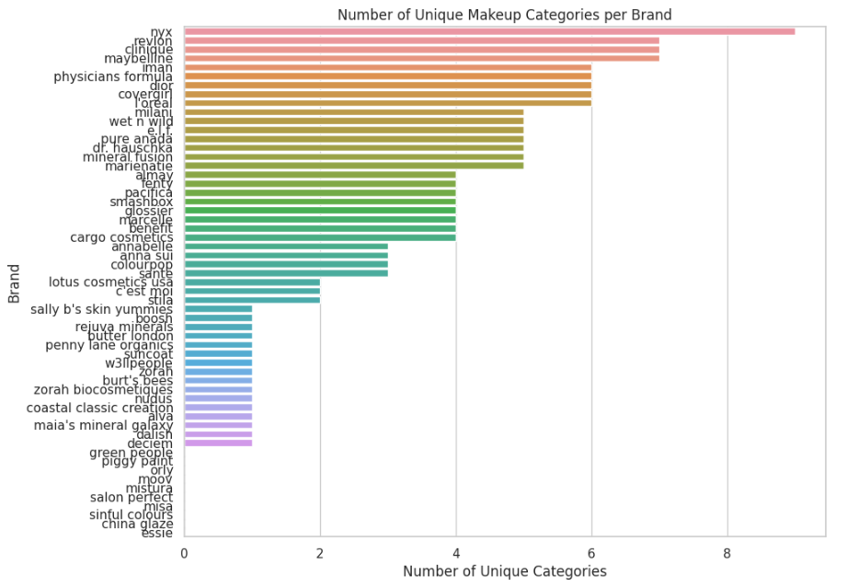
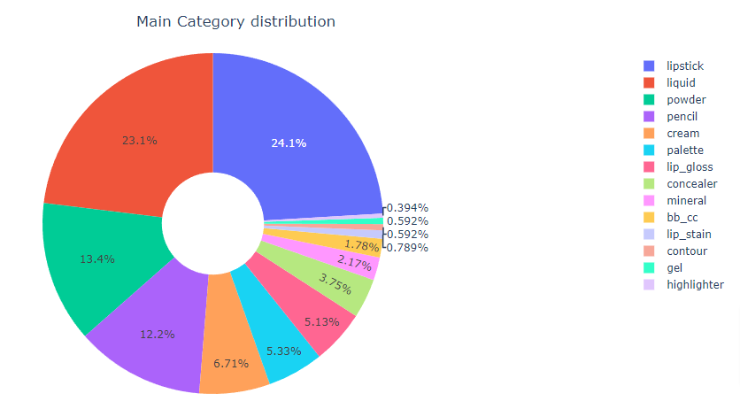
Consumer Category Behavior
For new analyzes of the number of distinct categories per Makeup Brand (only brands originating from makeup dataset):
Marketing Business Intelligence | Insights & Strategies

Slide 32
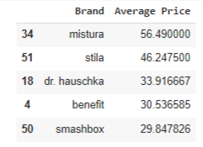
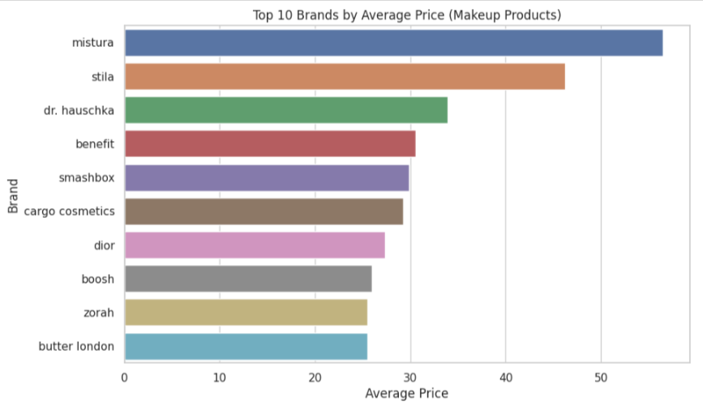
Consumer Category Behavior
Pricing and Brand Analysis
To identify which Premium Brands and Sales Volume by Brand are possible. :
Marketing Business Intelligence | Insights & Strategies

Slide 33
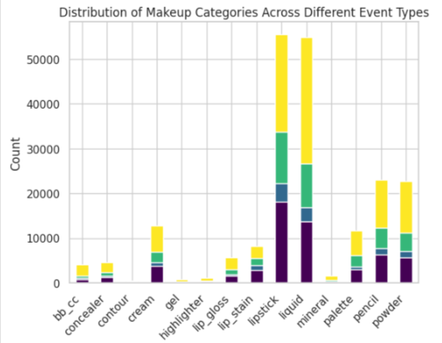
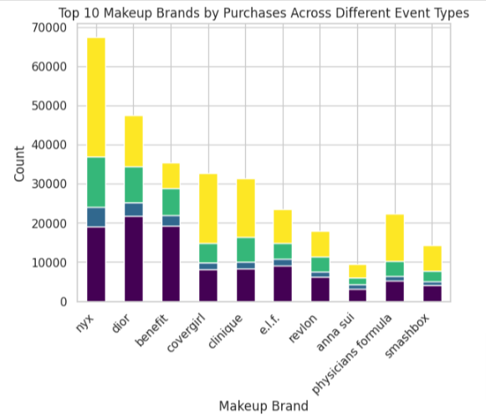
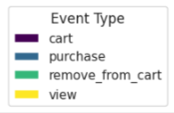
Consumer Category Behavior
Purchase Events and Purchase Patterns
These charts offer different perspectives on which makeup categories are most popular in terms of purchases:
Marketing Business Intelligence | Insights & Strategies

Slide 34
Consumer Category Behavior
Insight:
How makeup brands are interacted with by users in different contexts, such as shopping, views, and interactions with the shopping cart.
Suggestion:
Create personalized marketing campaigns based on purchasing behavior. Studying the consumer’s path from viewing to purchasing to understand purchasing patterns better.
Marketing Business Intelligence | Insights & Strategies

Slide 35

Conclusion
So... What can you do?
Summary of the key insights and recommendations.
The impact of these strategies on overall marketing effectiveness.
In conclusion, the analysis offers a roadmap for refining marketing strategies in the cosmetics e-commerce domain. Implementing these data-driven strategies is expected to significantly bolster the overall marketing effectiveness, leading to increased sales, customer satisfaction, and brand loyalty.

Slide 36
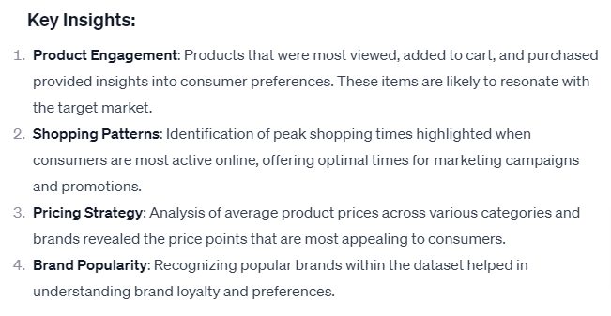
Conclusion
So... What can you do?
So, based on our analysis of this dataset, several key insights and strategic recommendations can be drawn to enhance the overall effectiveness of marketing efforts in the cosmetics e-commerce sector:

Slide 37
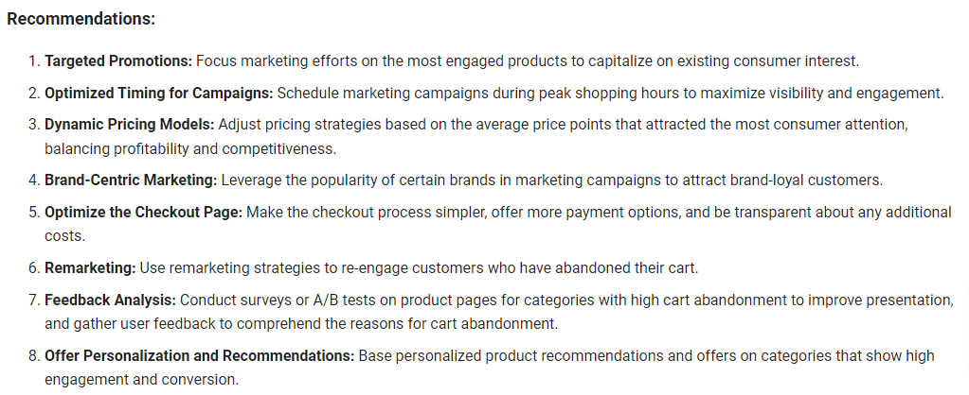
Conclusion
So... What can you do?
So, based on our analysis of this dataset, several key insights and strategic recommendations can be drawn to enhance the overall effectiveness of marketing efforts in the cosmetics e-commerce sector:

Slide 38
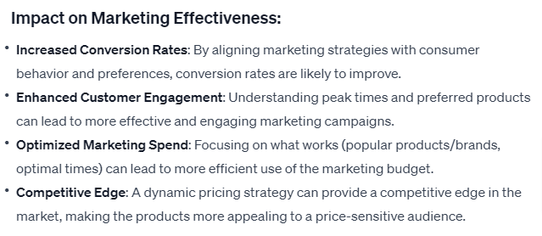
Conclusion
So... What can you do?
So, based on our analysis of this dataset, several key insights and strategic recommendations can be drawn to enhance the overall effectiveness of marketing efforts in the cosmetics e-commerce sector:

Slide 39

Thank you for the opportunity to show my qualifications in this process.
Feedback is always welcome! ^^
Looking forward to the invitation to become a Racer at Autoforce.
Ricardo V M Almeida | Data Analytics & Science
ricardovictorm@gmail.com

